Slide 1
Notes:
Presentation to the Mobile Money Conference, Dubai, October 2009.
All photo credits listed in slide notes.
Photo: Researching in Dharavi, Mumbai, Jan Chipchase, 2007.

Slide 2
Notes:
It takes a team or 6.

Slide 3
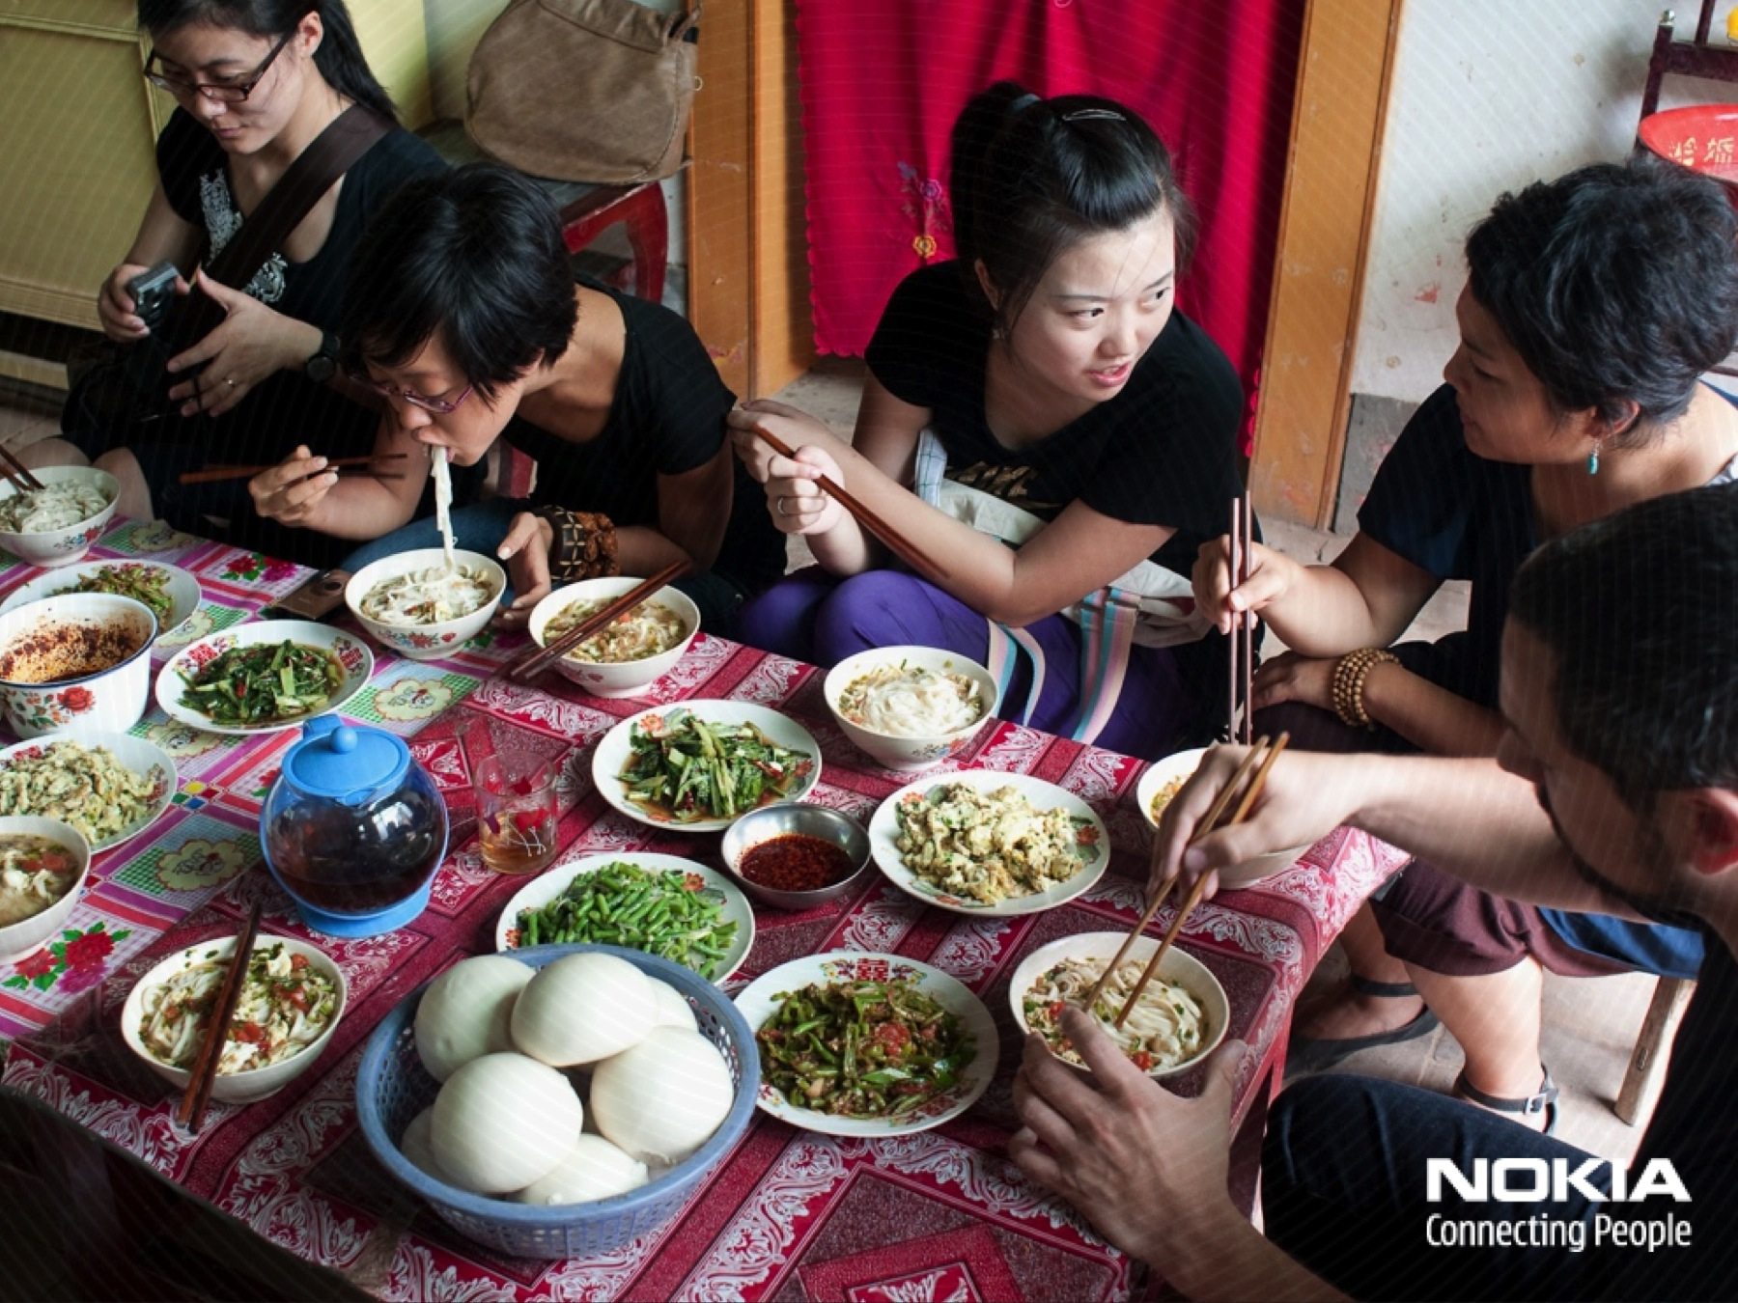
Notes:
Photo: Team meal, rural China, Jan Chipchase, 2009.

Slide 5
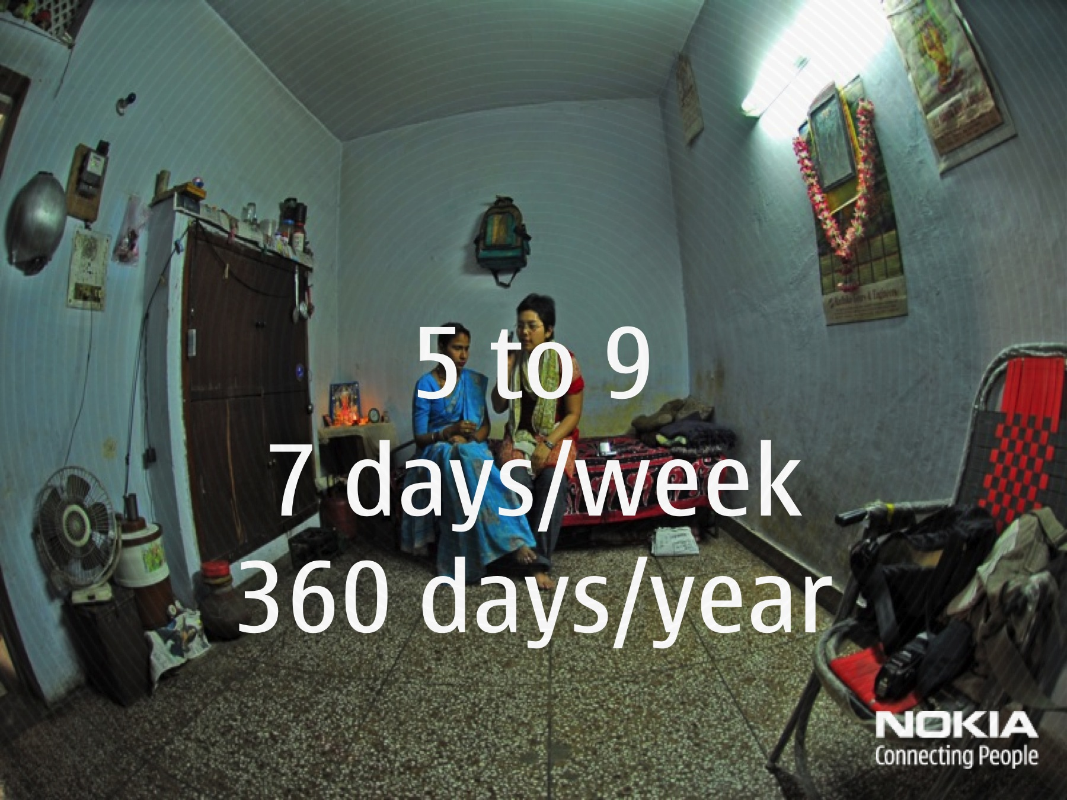
Notes:
Photo: Zeenath Hasan conducts a home interview - Delhi, India, Jan Chipchase, 2004.

Slide 6
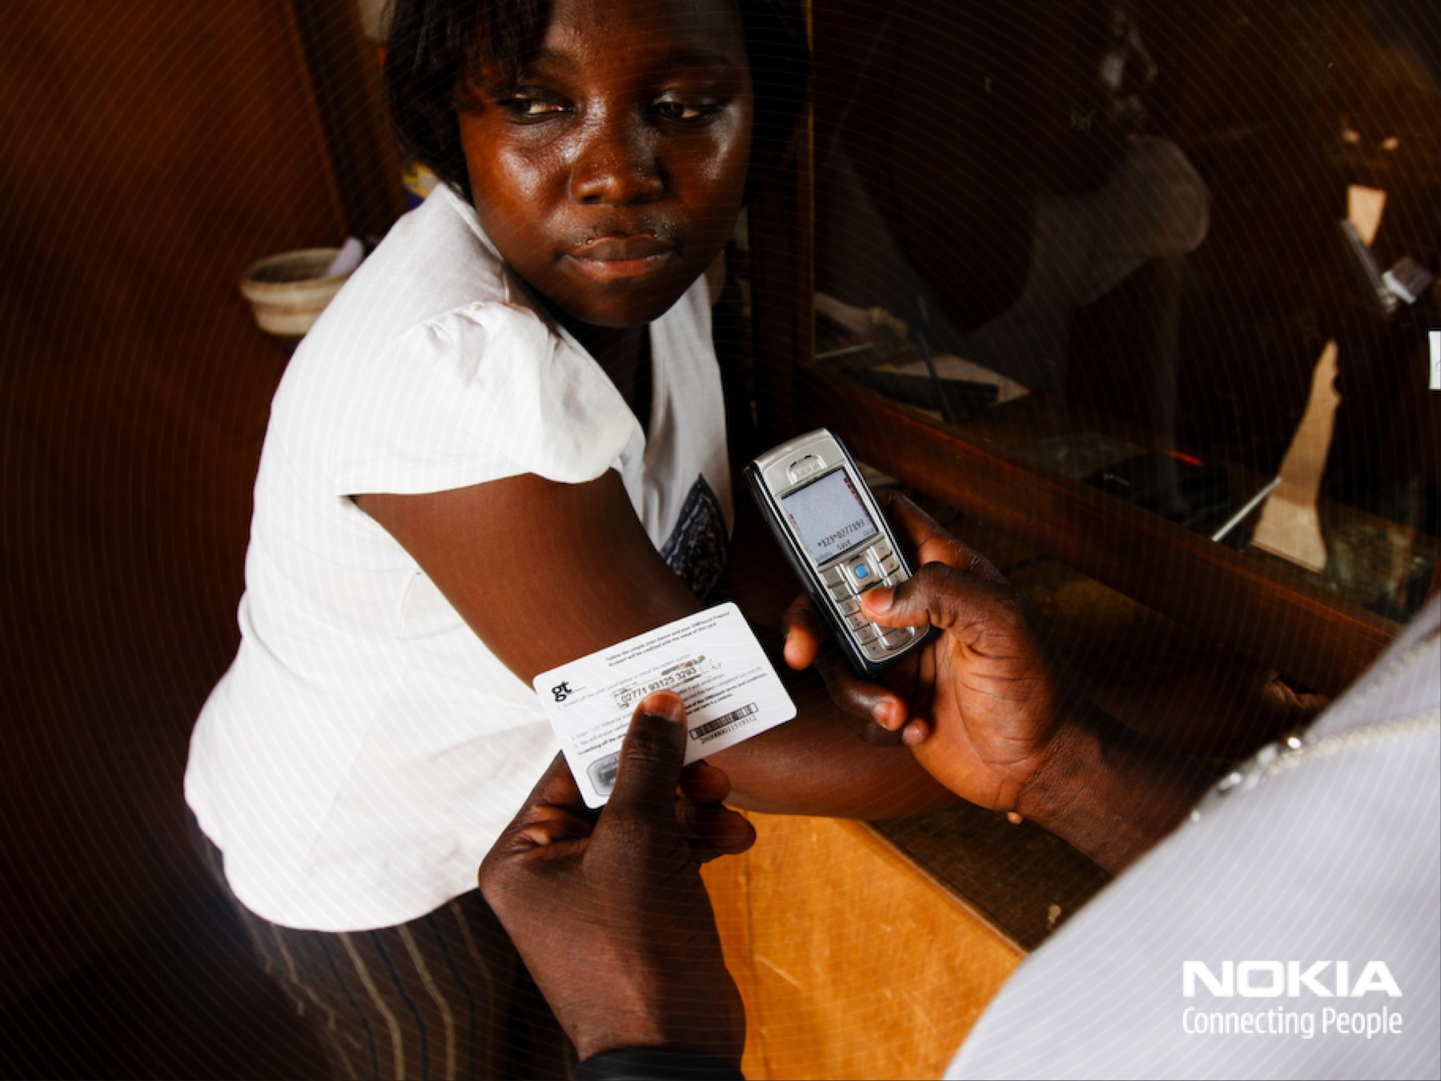
Notes:
Photo: Topping up phone credit Accra, Ghana, Jan Chipchase, 2007.

Slide 7
Notes:
Photo: ~50 people to a room - dorm life in Xi’an, China. John Evans, 2009.

Slide 9
Notes:
Photo credits: Candy Chang, John Evans, Michiel Terlouw, Zeenath Hasan & Jan Chipchase, Xi’an, Shanghai, China, 2009.

Slide 10
Notes:
Photos: Los Angeles, Helsinki, Chengdu, Joho Bahru, Ahmadabad, Accra and Kobrasol, Jan Chipchase, 2004 – 2009.

Slide 11
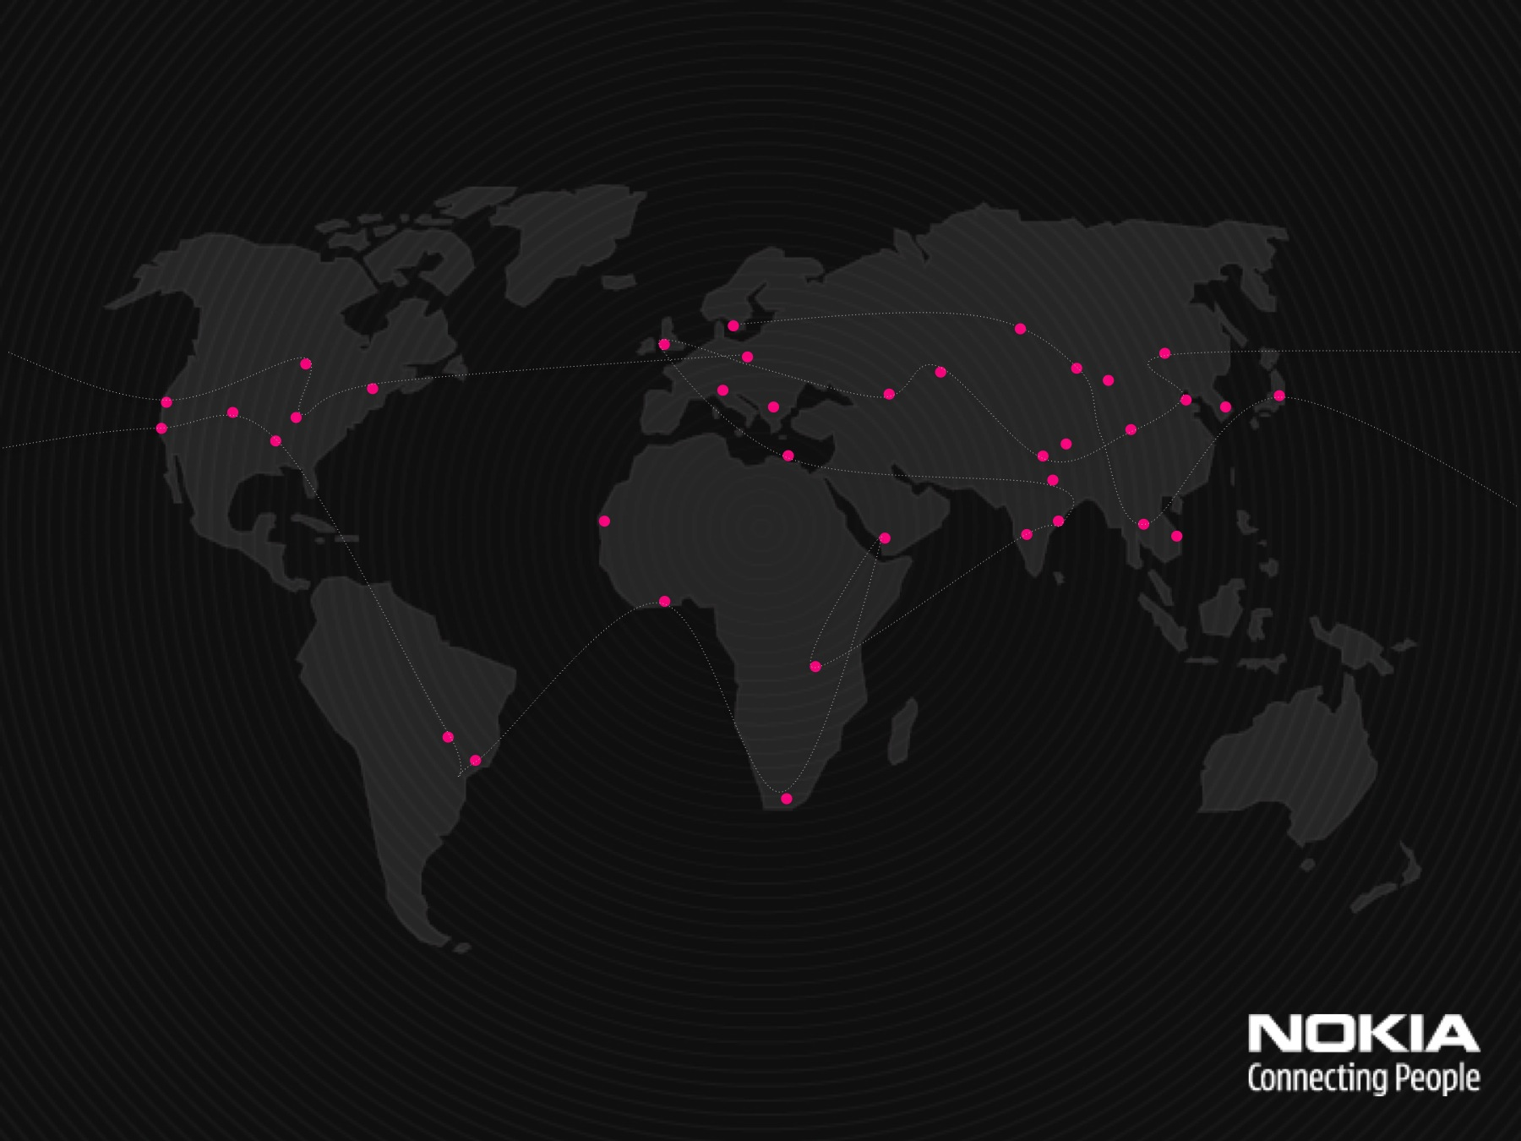

Slide 14
Notes:
Photo: John Evans, Medan, Indonesia, 2009.

Slide 15
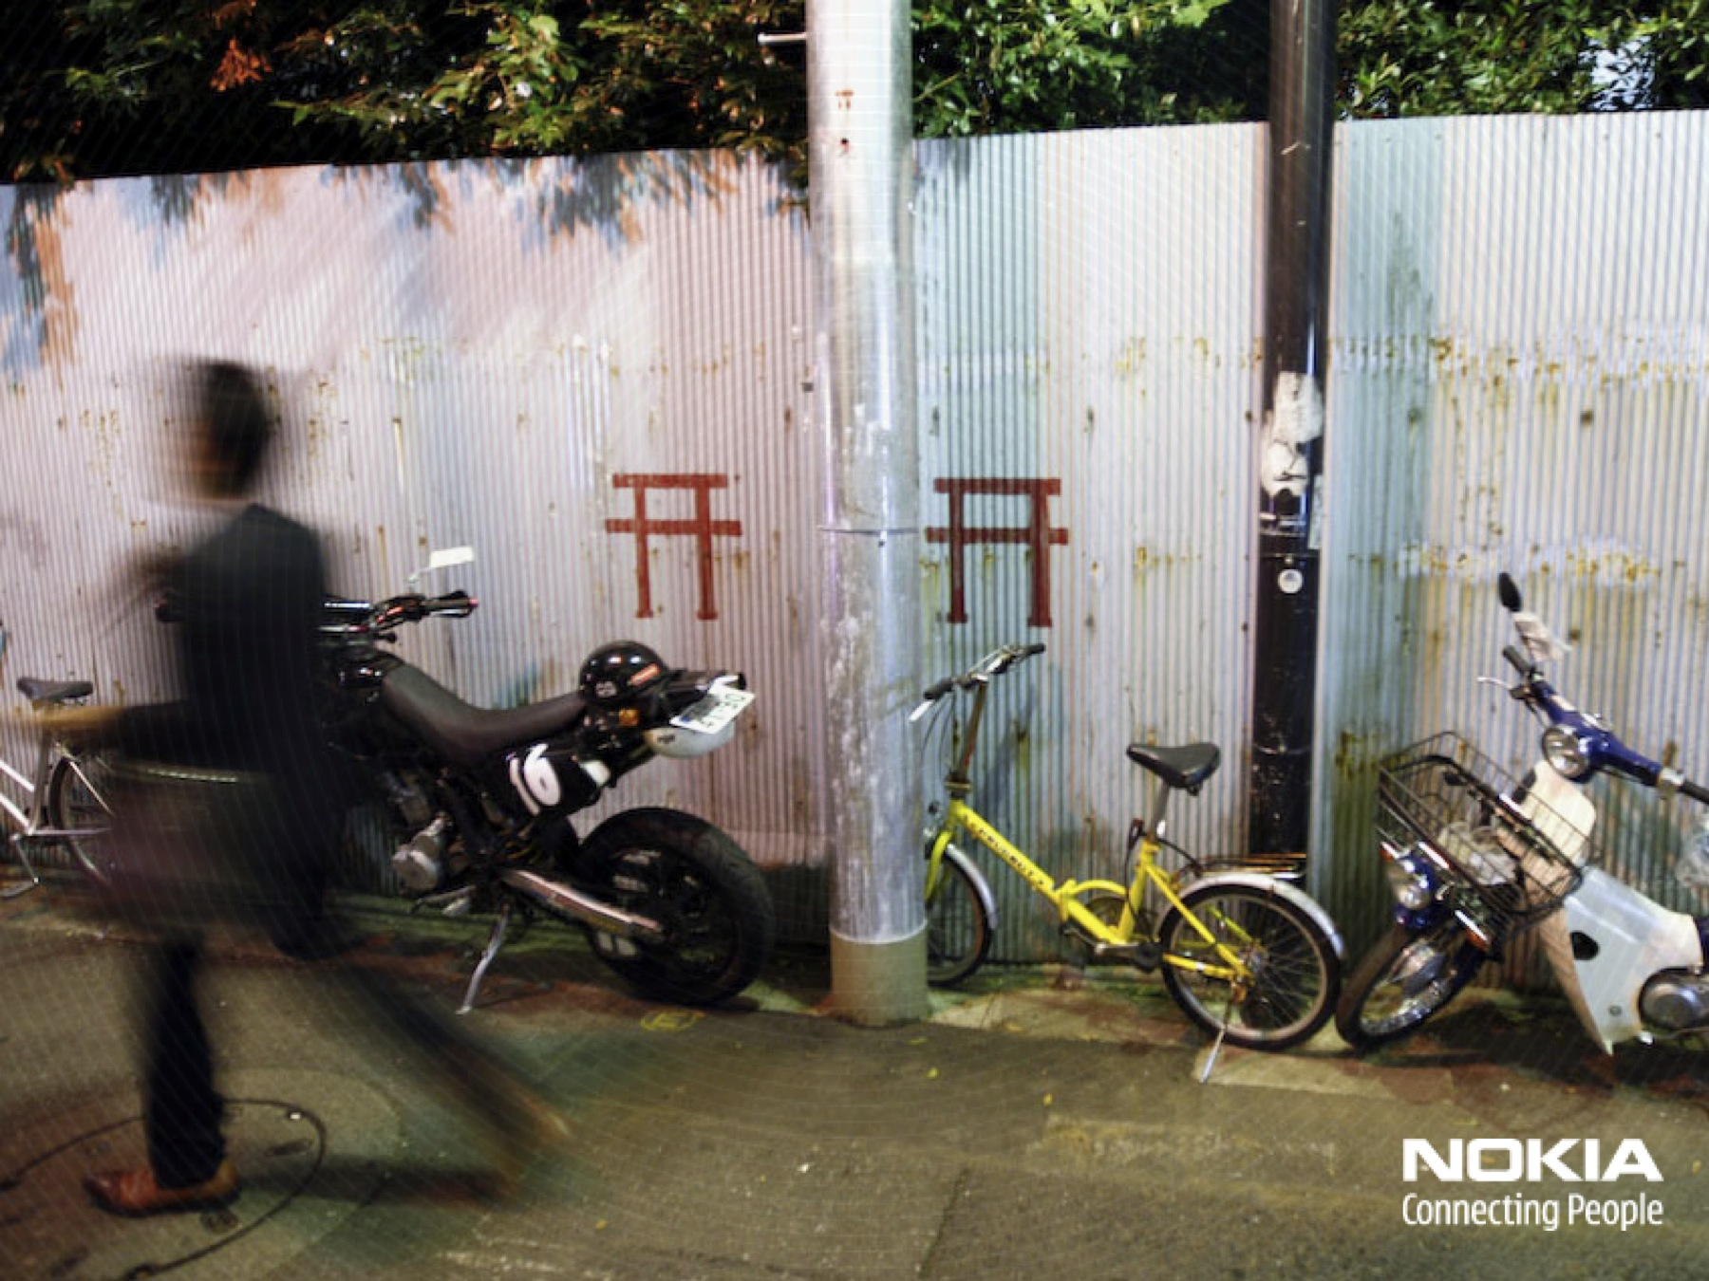
Notes:
Photo: Tokyo, Jan Chipchase, 2008.

Slide 18
Notes:
Photo: Hue, Vietnam, Jan Chipchase, 2009.

Slide 19
Notes:
Photo: Hue, Vietnam, Jan Chipchase, 2009.

Slide 21
Notes:
Photo: Current account savings book, rural location outside Xi’an, China. John Evans, 2009.

Slide 22
Notes:
Thanks to the Nokia Messaging team for this example.

Slide 23
Notes:
Photo: Jan Chipchase, Kansensero, Uganda, 2006

Slide 24
Notes:
Photo: Nokia, Hangzhou, China, 2003.

Slide 26
Notes:
Photo: Wallet as present, money as emotional, rather than transactionable gift. Joho Bahru, Malaysia, Jan Chipchase, 2009.

Slide 29
Notes:
Photo: the use of multiple mobile phones to manage multiple identities, to reduce communications costs or to obtain better coverage. Accra, Ghana, Jan Chipchase, 2007.

Slide 38
Notes:
Photo: The susu savings scheme in Accra, Ghana - save 31 installments, and receive 30 back at the end of the month. Jan Chipchase, 2007.

Slide 39
Notes:
Photo: Gold as a popular medium of storage. Dharavi, Mumbai, Jan Chipchase, 2007.

Slide 40
Notes:
Photo: Can you spot where the savings are kept? Dharavi, Mumbai, Jan Chipchase, 2007.

Slide 41
Notes:
Photo: The need to save for life-events in particular weddings and funerals. Ahmadabad, India, Jan Chipchase, 2008.

Slide 42
Notes:
Photo: The need to smooth out earnings and debt, for example borrowing to pay for the next crop. Rural location outside Ahmadabad, India, Jan Chipchase, 2008.

Slide 43
Notes:
Photo: The practice of pooling resources occurs in situations where individuals cannot afford a service, or wish to reduce the transaction costs on that service, where a sufficiently trusted network of people are willing to work together. Pooling often makes sense for remittancing cash. Kampala, Uganda, Jan Chipchase 2004.

Slide 45
Notes:
Photo: Kanesensero, Uganda, Indri Tulusan, 2004.

Slide 46
Notes:
Photo: Kansensero, Uganda, Indri Tulusan, 2004.

Slide 48
Notes:
Photo: The dual-SIM street hack. Accra, Ghana, Younghee Jung, 2007.

Slide 58
Notes:
Photo: Depending on your usage, Ahmadabad, India, Jan Chipchase, 2007.

Slide 61
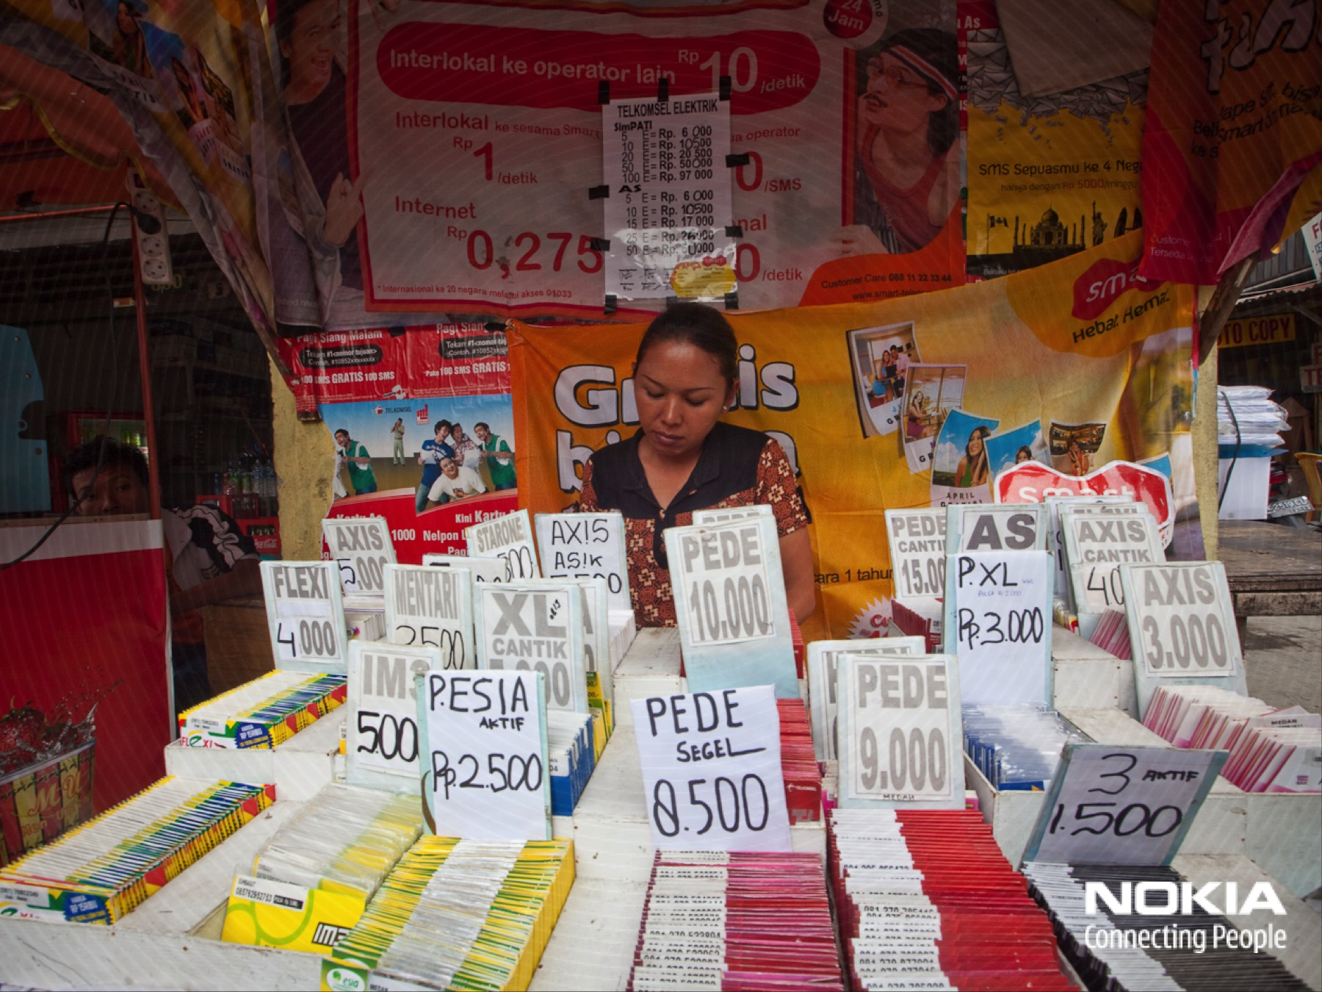
Notes:
Photo: Medan, Indonesia, John Evans, 2009.

Slide 64
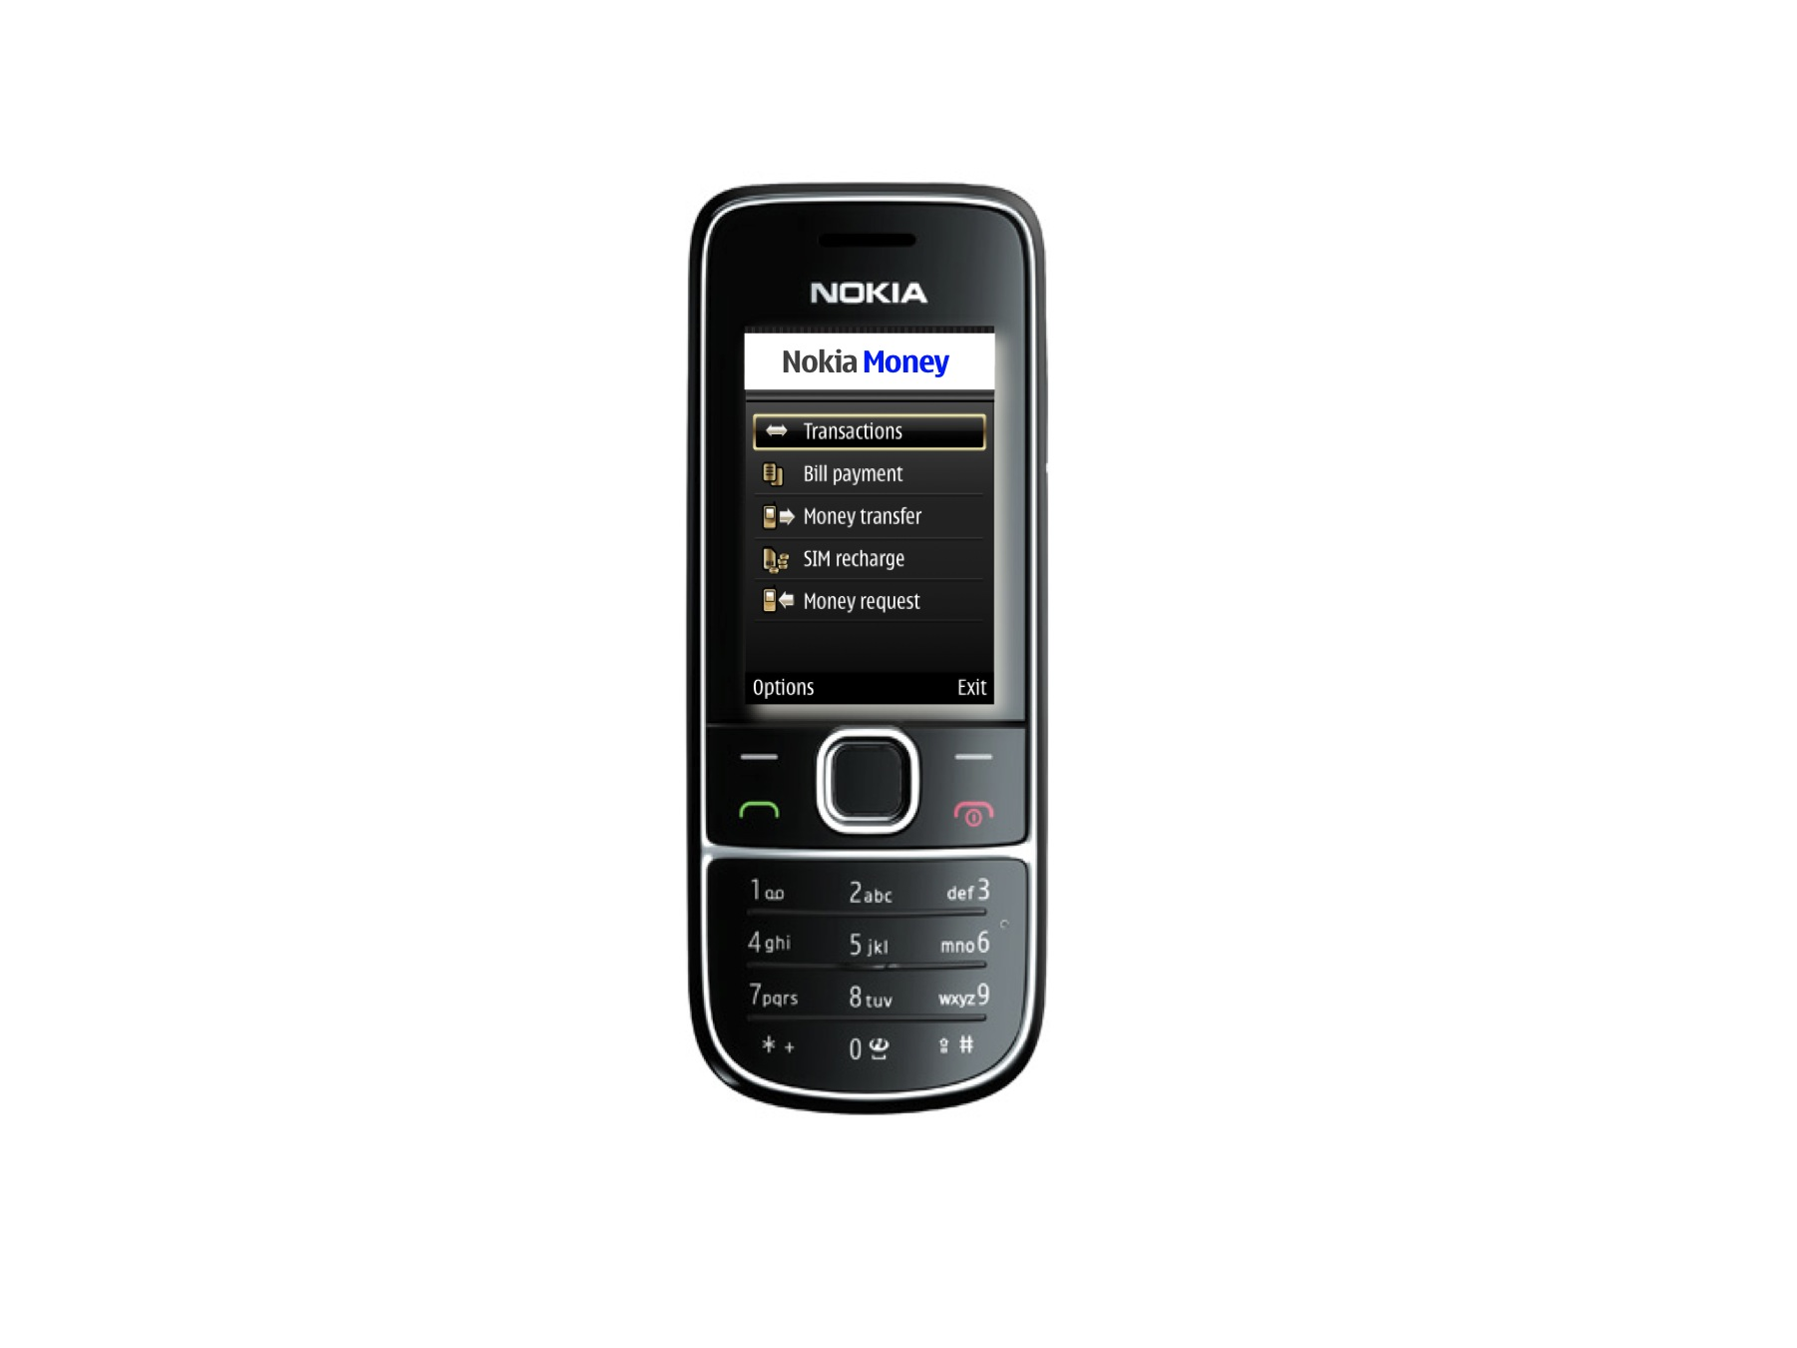

Slide 65
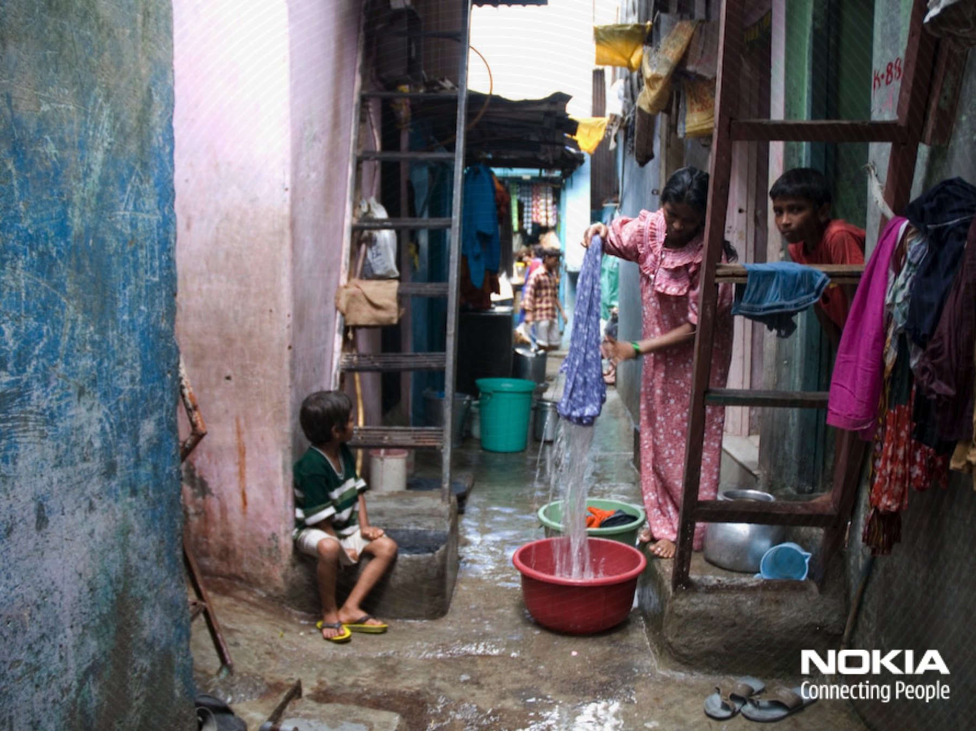
Notes:
Photo: Sophisticated financial strategies in Dharavi, Mumbai, Jan Chipchase, 2007.

Slide 66
Notes:
Photo: Sophisticated financial strategies in Dharavi, Mumbai, Jan Chipchase, 2007.

Slide 67
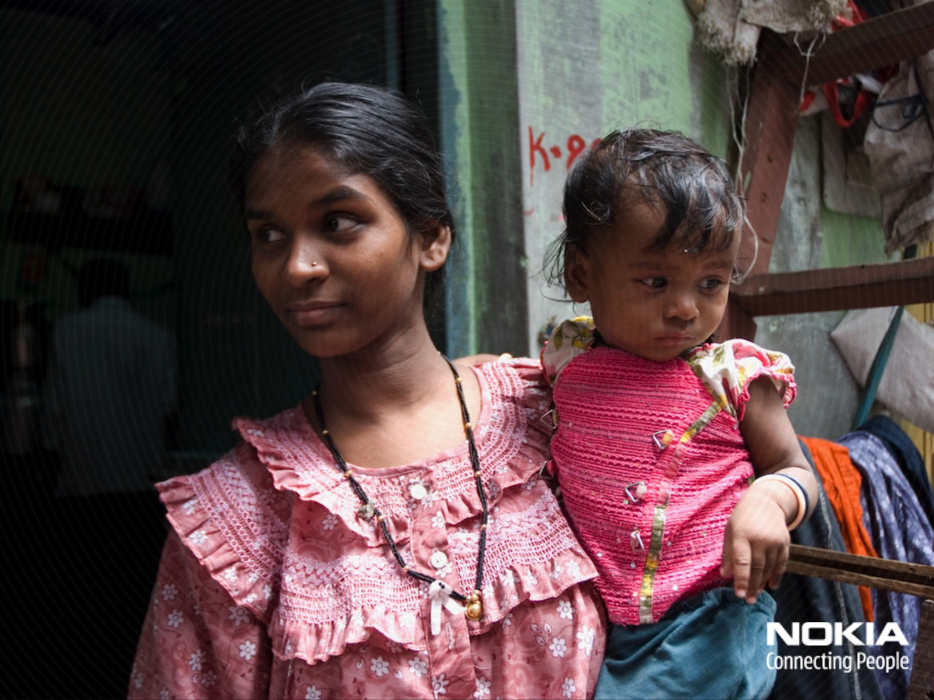
Notes:
Photo: Sophisticated financial strategies in Dharavi, Mumbai, Jan Chipchase, 2007.

Slide 69
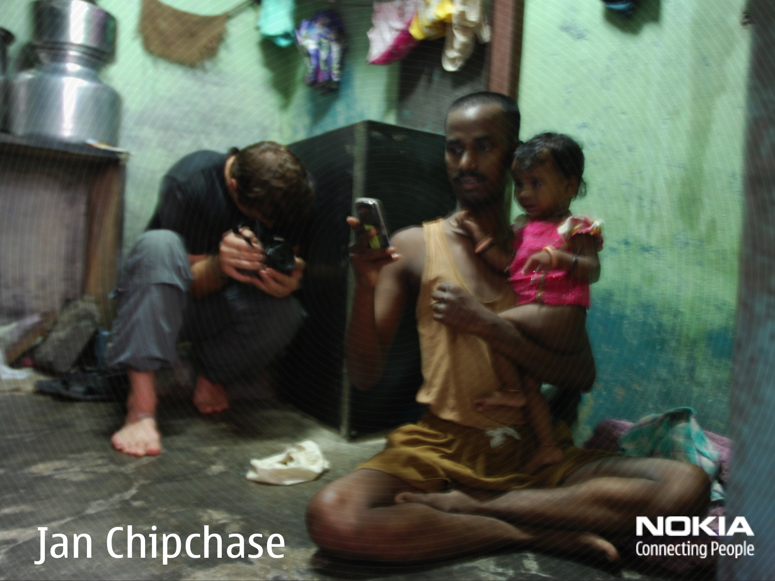
Notes:
Photo: Jan Chipchase working in the field, Dharavi, Mumbai, Zeenath Hasan, 2007.

